Slide 1






Improved Description of Electron-Plasmon coupling in Green’s function calculations
Jianqiang (Sky) ZHOU, Lucia REINING

Slide 2
Motivation
Why GW approximation fails for the satellite structure?
Why the cumulant is good?
Can we do better? And how??
Matteo Guzzo, Giovanna Lani et al. PRL.107 166401(2011)
Notes:
In my phd subject, I will mainly deal with the photoemission spectra properties of some strong correlated system. Which means I am not only interested the quasi-particle excitations that is already to be seen as well described by GWA. I am also interested in the satellite structures in the spectra, that induced by the plasmon excitions. So in this talk, I will show you that the GWA is good for describing the QP excitations and fails describing the plasmon excitations and I will also tell you why. In addition I will introduce you the cumulant expansion approximation method developed in our group, which can be seen as a theory beyond GWA. It can describe the coupling between the particles and the plasmon excitions. So as we can get the correct satellite structure. But our cumulant is not the end of this field. I am trying to develop a theory beyond what we alread got, so in this talk I will introduce you from what aspect I am going to improve on top of our cumulant and why, how?

Slide 3
Outline
Theoretical background
  One-particle Green’s function and the spectral function
  GW approximation
  Lars Hedin,Phys. Rev., 139:A796-A823 (1965)
  The Cumulant expansion approximation
Giovanna Lani, Pina Romaniello et al. New Journal of Physics, 14(1):013056, 2012
Matteo Guzzo, Giovanna Lani et al. PRL.107 166401(2011)
Model calculation: one- and two-level electron-boson coupling model
  One-level model: the origin of the cumulant
  D. Langreth, Phys. Rev. B 1, 471, (1970)
  Two-level model: the coupling effect between levels
  O. Gunnarsson, Phys. Rev. B 50, 10462, (1994)
Full functional differential equation calculation
  Go beyond the decoupling approximation
Notes:
Till now, we already studied the cumulant expansion and know what kind of approximations involved in the cumulant. My study is how to go beyond these approximations. The first approximation I am gona relax is the decoupling approx. How? Our cumulant is nothing else than the one level electron plasmon coupling model where we have the exact solution. And the two-level models, which also can be solved exactly, can tell us how good (or bad) of this decoupling approx because it contains coupling between levels. From the study of these two models, we might be able to get some insights that can help us to go beyond the decoupling approx and further more, get better cumulant.

Slide 4
Outline
Theoretical background
  One-particle Green’s function
  GW approximation
  The Cumulant expansion approximation
Giovanna Lani, Pina Romaniello et al. New Journal of Physics, 14(1):013056, 2012
Matteo Guzzo, Giovanna Lani et al. PRL.107 166401(2011)
Model calculation: one- and two-level electron-boson coupling model
  One-level model: the origin of the cumulant
  D. Langreth, Phys. Rev. B 1, 471, (1970)
  Two-level model: the coupling effect between levels
  O. Gunnarsson, Phys. Rev. B 50, 10462, (1994)
Full functional differential equation calculation
  Go beyond the decoupling approximation
Notes:
Till now, we already studied the cumulant expansion and know what kind of approximations involved in the cumulant. My study is how to go beyond these approximations. The first approximation I am gona relax is the decoupling approx. How? Our cumulant is nothing else than the one level electron plasmon coupling model where we have the exact solution. And the two-level models, which also can be solved exactly, can tell us how good (or bad) of this decoupling approx because it contains coupling between levels. From the study of these two models, we might be able to get some insights that can help us to go beyond the decoupling approx and further more, get better cumulant.

Slide 5
One-particle Green’s function
The probability amplitude for one particle at (1) propagating to (2)
(2)
(1)
Electron propagator
Hole propagator
Notes:
What is the one-particle GF? It is also called the particle propagation operator. Why? Because it represents the probability amplitude for one particle at (r’t’) propagating to (rt). Here it is the definition of the one-particle GF. Depending on creating electron or hole at the beginning, it can be separated into two GFs, namely electron propagator and hole propagator, respectively. Explain all the quantities… Many-body ground state wavefunction. Field operator in the Hersenburtg picture.

Slide 6
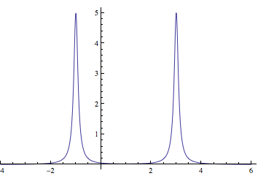
The spectral function
Photoemission-hole part
Inverse Photoemission-electron part
Band gap
Notes:
The spectra is the main quantity we gona study in this talk. And by definition, it can be calculated from the imaginary part the the GF. To be visualized, I take one example to show you how is the spectral calculated

Slide 7

GW Approximation
Polarization made of non-interacting electron hole pairs (RPA)
Classical (Hartree) interaction between additional charge and polarization charge (no exchange correlation effect)
Notes:
Here it is the GW approximation and this is my favorite picture that represents the GW approximation. It is true. GW assume the solids as a cup of water. The excitation in the solid is like we through a stone into the water. What will happen? Everybody knows there will be water wave propagating on the water surface and the further the propagating, the smaller the wave amplitude. And what we do in GW? The water wave is the same as the electron density vibration. And we treat this vibration as the polarization that made of non-interacting electron hole pairs. And the first excited particle is treated differently (blue electron (hole)). The interaction between this particle with the rest of the system is classical Hartree interaction.
These two comments are the main approximation involved in GW approximation and I will dig into detail later.
No electron and hole interaction in the system except between the additional charge (due to excitation) and the left system. Electron-electron interaction are screened and represented by W. The interaction between the additional charge (due to excitation) and the left system is represented by the classical Hartree interaction.

Slide 8
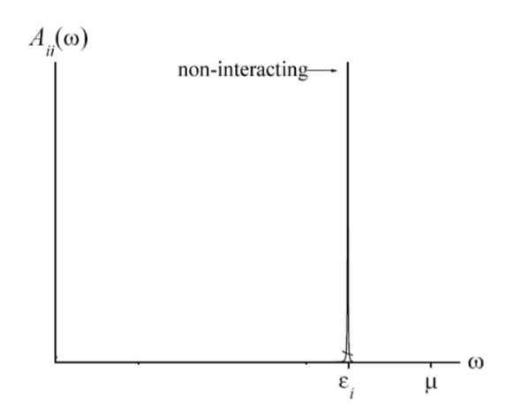
Non-interacting particles-Hartree Fock
The GWA is a generalization of the Hartree-Fock Approximation (HFA) but with a dynamically screened Coulomb interaction.
Electrons are not allowed to relax after excitation, so the life time is infinite
Notes:
The GWA may be regarded as a generalization of the Hartree-Fock Approximation (HFA) but with a dynamically screened Coulomb interaction. So what does HF treat the solids? It treat the electrons in the solids as non-interaction particles. Imagine we have a many-electron system, the excitation remove one electron from this system. What kind of spectra we will get from HF? There will be one hole left in the system. Because there is no interaction between electrons so the electron cannot be relaxed. It means the excitation life time is infinite. Therefore, we get a delta peak in the spectra and the position of this delta peak will be at the energy level that electron stayed.

Slide 9
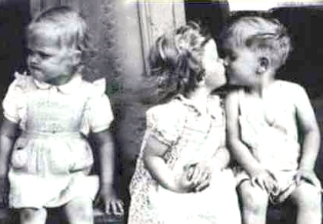
Interacting particles
Signature 1: Polarization (in the rest of the system) made of non-interacting electron hole pairs (RPA)
The rest = without the blue hole
Quasi-particles
No interaction in GW !!
In the cumulant expansion, the electron density fluctuation is represented by the bosonic field-plasmon
Notes:
After understanding what is HF we can then understand how does it be generalized into GW. First, in GW the electron interacts with each other. The same picture like HF but with interacting electrons. What is the consequent of this interaction. The excitation will induce relaxation of other electrons in the system. Thus all the electrons will leave from their original positions and create the polarization. Each electron will create one hole. Then the electrons are surrounded by positively charged cloud and becomes quasiparticles. The interaction between the quasiparticles are represented by the dynamical screened Coulomb interaction W. From this slide we can understand the first commend.

Slide 10
Interacting particles
Signature 2: the blue hole only feels classical induced Hartree potential created by the rest of the system (without exchange correlation contribution)
In the cumulant expansion, this interaction is represented by the coupling between electron (hole) and the plasmon
Notes:
Then we try to understand commend of GWA. … what does this mean? After excited, basically we have three kinds of particles. One blue hole, one electron and the hole created by the polarization. Actually the main problem in the many-body problem is how to treat the interaction of these three particles. The first command already told us there is no interaction between the white hole and the electron. So the problem is what is the interaction GWA put between the blue hole and the rest of the system? The answer is the classic Hartree interaction.

Slide 11
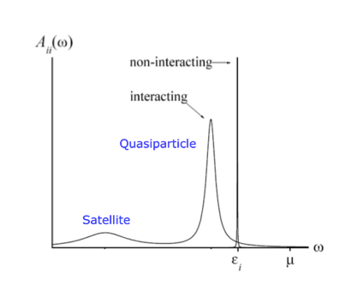
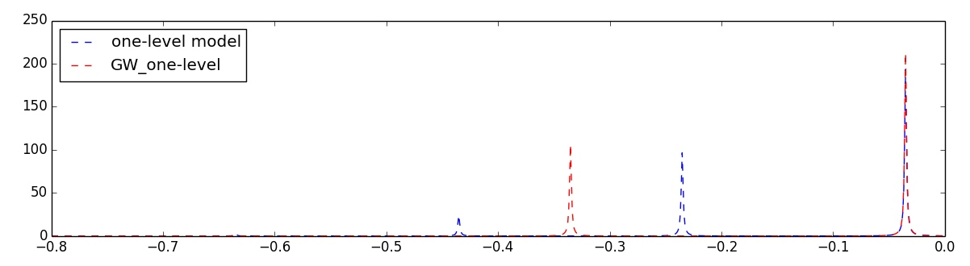
Spectral function calculated from GW Approximation
the exact and GW spectra in the one-level model
Notes:
Now we already understand everything about the GW approximation. Then you may ask what is the spectra calculated from GW. What is the difference between HF spectra and the GW one? Here it is one example of the spectra calculated by HF and GW. We can see because of the interaction, the delta peak in the HF becomes two broaden peaks in GW. The delta peak shift to lower energy because the quasiparticle has less energy compare with the bare electron. And there is a new structure appeared in the lower energy that is called the satellite in the spectra. In GW, not all the excitation energy is in the quasiparticle peak but also some excitation energy goes to create the satellite. We can say, the satellite is the signature of the Screened Coulomb interaction.

Slide 12
One-level electron-plasmon coupling model
Core level
Plasmon energy
Coupling between core level and plasmon
Z factor
Shift QP
Satellites
the exact and GW spectra in the one-level model

Slide 13
Cumulant expansion approximation of Green’s function
Taylor expansion of GF
The cumulant expansion
e.g. the second order term
The second order cumulant GF = The exact solution of the one-level model
Migdal A, sov. Phys. JETP 7 996, 1958 & L. Hedin J. Phys 1999
Notes:
The first question you may ask is, what is the cumulant? From the mathematical point of view, it is just another kind of expansion compared to the Taylor expansion, which involves the exponential expansion. Here I show you one example of both expansion of GF. the first line is the normal Taylor expansion and the second line is the cumulant expansion of the same GF. The coefficient of the second expansion is called the cumulant. Then how to calculate the cumulant from this definition? The systemic way to solve this is to calculate this equation order by order. For example, the second order term will be… From this equation we can express the second order cumulant as a function of the second order GF. Here G0 is the non-interacing GF which we already know when we define the system. Then the only question is how to calculate this second order GF. In this example, we work on this Hamiltonian, from which, we can calculate all orders of GW self-energies, so as the GFs. Taking the second order GF we can calculate the second order cumulant. Then the cumulant expansion 0f GF. Here I show you the result of the cumulant GF. I will explain the detail later here what I want to show you is only the structure of the so-called cumulant GF. You can see, there is one exponential term in the exponent. We can expand this exponential term into a series then FT into the frequency space. We can imagine, in the spectra, there will be one shift quasiparticle peak together with infinite satellites. The distance between satellites is the plasmon energy.

Slide 14
The cumulant developed in our group
Full functional differential equation (DE) : exact but not solvable
Nonlinear!
Linearized functional differential equation (LDE) : the first approximation in cumulant
Gordon Baym and Leo P. Kadanoff, Phys. Rev. 124, 287-299 (1961)
Notes:
The full functional DE comes from the equation of motion of the non-equilibrium GF. Yesterday Falk Tandetzky already introduced you all about the EOM of the equilibrium GF. But here we work on the non-aquarium because of this external potential also dependents on time and space.

Slide 15
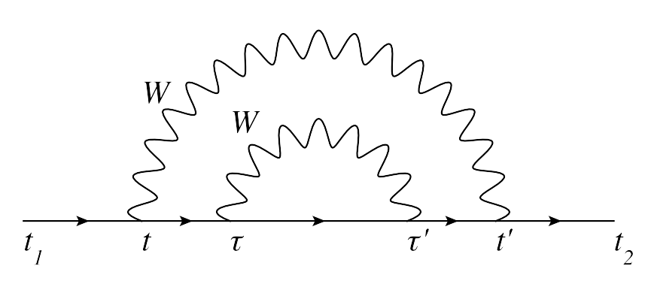
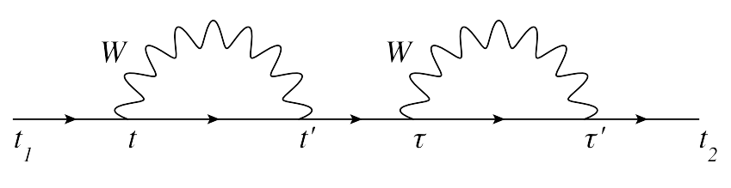
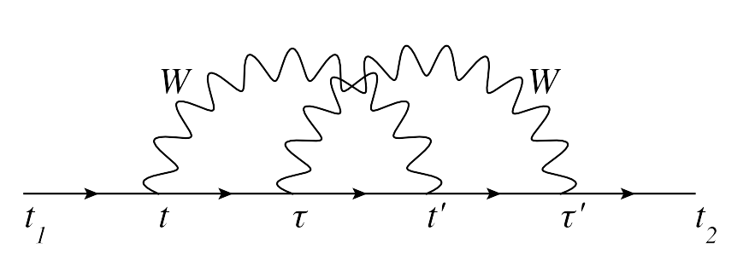
The cumulant developed in our group
GW approximation
Decoupling approximation
The cumulant expansion
G is upgraded in the iteration
Two plasmon excited simultaneously

Slide 16
Outline
Theoretical background
  One-particle Green’s function
  GW approximation
  The Cumulant expansion approximation
Giovanna Lani, Pina Romaniello et al. New Journal of Physics, 14(1):013056, 2012
Matteo Guzzo, Giovanna Lani et al. PRL.107 166401(2011)
Model calculation: one- and two-level electron-boson coupling model
  One-level model: the origin of the cumulant
  D. Langreth, Phys. Rev. B 1, 471, (1970)
  Two-level model: the coupling effect between levels
  O. Gunnarsson, Phys. Rev. B 50, 10462, (1994)
Full functional differential equation calculation
  Go beyond the decoupling approximation
Notes:
Till now, we already studied the cumulant expansion and know what kind of approximations involved in the cumulant. My study is how to go beyond these approximations. The first approximation I am gona relax is the decoupling approx. How? Our cumulant is nothing else than the one level electron plasmon coupling model where we have the exact solution. And the two-level models, which also can be solved exactly, can tell us how good (or bad) of this decoupling approx because it contains coupling between levels. From the study of these two models, we might be able to get some insights that can help us to go beyond the decoupling approx and further more, get better cumulant.

Slide 17

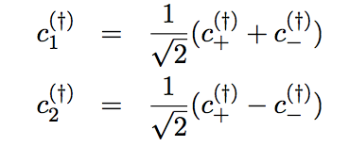
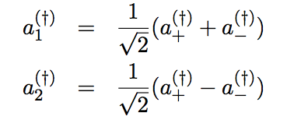
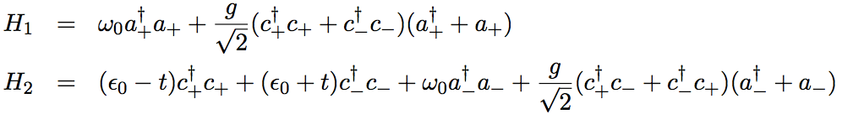
Two-level electron-plasmon coupling model
Two-level model
No analytical result for the second Hamiltonian!
Notes:
----- 会议笔记(12-5-16 11:33) -----
we need the experimental results

Slide 18
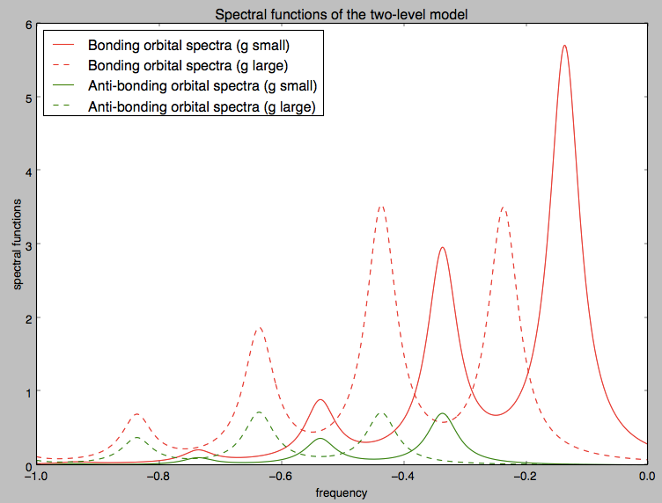
Two-level electron-plasmon coupling model
Z factor
The anti-bonding level is also occupied in the ground state.
The larger the coupling, the more the anti-bonding level is occupied
g increases
Notes:
How to plot the dynamic plot with the changing of coupling constant, show the changing of the spectral.

Slide 19
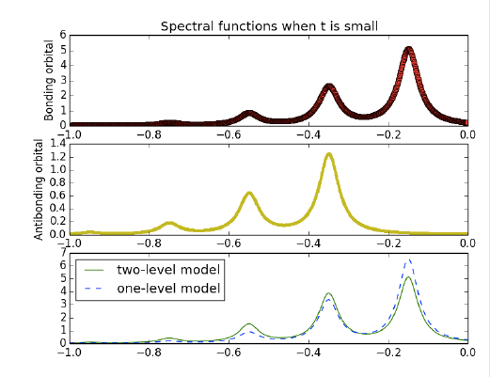
Spectral function of electron-plasmon model
Z factor
Notes:
----- 会议笔记(12-5-16 11:33) -----
we need the experimental results

Slide 20
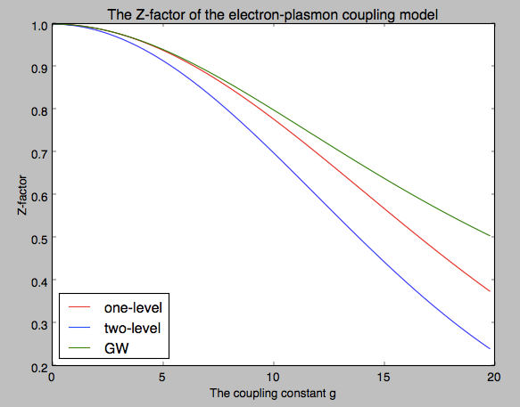
The quasi-particle strength-Z factor
GWA in one-level model
The GW has the largest quasi-particle weight
The coupling of levels will always lower the quasi-particle weight
Notes:
----- 会议笔记(12-5-16 11:33) -----
we need the experimental results

Slide 21
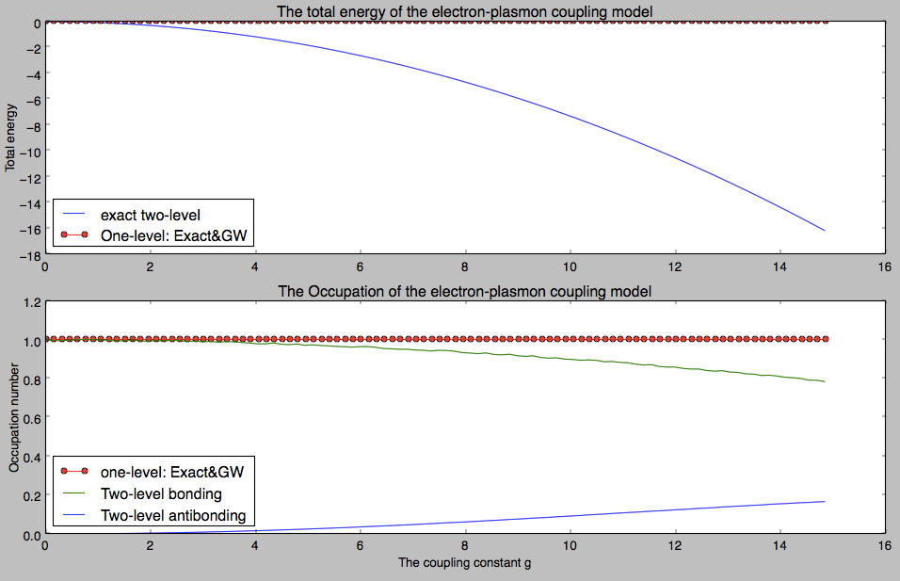
Total energies and the Occupation number
GW total energy is the same as the exact one although it fails describing the satellites
Coupling lowers the total energy
GW has exact occupation
Coupling lowers the occupation of the bonding level but increases the anti-bonding level occupation

Slide 22
Outline
Theoretical background
  One-particle Green’s function
  GW approximation
  The Cumulant expansion approximation
Giovanna Lani, Pina Romaniello et al. New Journal of Physics, 14(1):013056, 2012
Matteo Guzzo, Giovanna Lani et al. PRL.107 166401(2011)
Model calculation: one- and two-level electron-boson coupling model
  One-level model: the origin of the cumulant
  D. Langreth, Phys. Rev. B 1, 471, (1970)
  Two-level model: the coupling effect between levels
  O. Gunnarsson, Phys. Rev. B 50, 10462, (1994)
Full functional differential equation calculation
  Go beyond the decoupling approximation
Notes:
Till now, we already studied the cumulant expansion and know what kind of approximations involved in the cumulant. My study is how to go beyond these approximations. The first approximation I am gona relax is the decoupling approx. How? Our cumulant is nothing else than the one level electron plasmon coupling model where we have the exact solution. And the two-level models, which also can be solved exactly, can tell us how good (or bad) of this decoupling approx because it contains coupling between levels. From the study of these two models, we might be able to get some insights that can help us to go beyond the decoupling approx and further more, get better cumulant.

Slide 23
Go beyond decoupling with a good ansatz Green’s function
A good ansatz should be, in principle exact

Slide 24


How to get a good ansatz Green’s function
With less terms, we can get good result. e.g., the state-of-the-art theory
GW approximation!

Slide 25

How to get a good ansatz Green’s function
Good time structure
Good space structure
Under decoupling, it gives us our cumulant!
Is it solvable? Cumulant involved coupling? Performance?

Slide 26
Conclusion and Outlook
GW has the exact total energy and the occupation number but with larger quasi-particle weight in the one-level model calculation.
Going beyond the decoupling approximation will lower the quasi-particle weight, the total energy and the occupation number of the bonding orbital.
The decoupling approximation will induce worse spectra in strong coupling system. Therefore it is necessary to go beyond this approximation
Test the combined ansatz Green’s function and proof it gives us the best cumulant. If not, try other ansatzs.
Cumulant beyond the linearization
Calculate the total energy of the two-level model with GWA – How to put the second electron in the Hamiltonian?

Slide 27

Thanks for your attention!
Questions?

